Slide 1
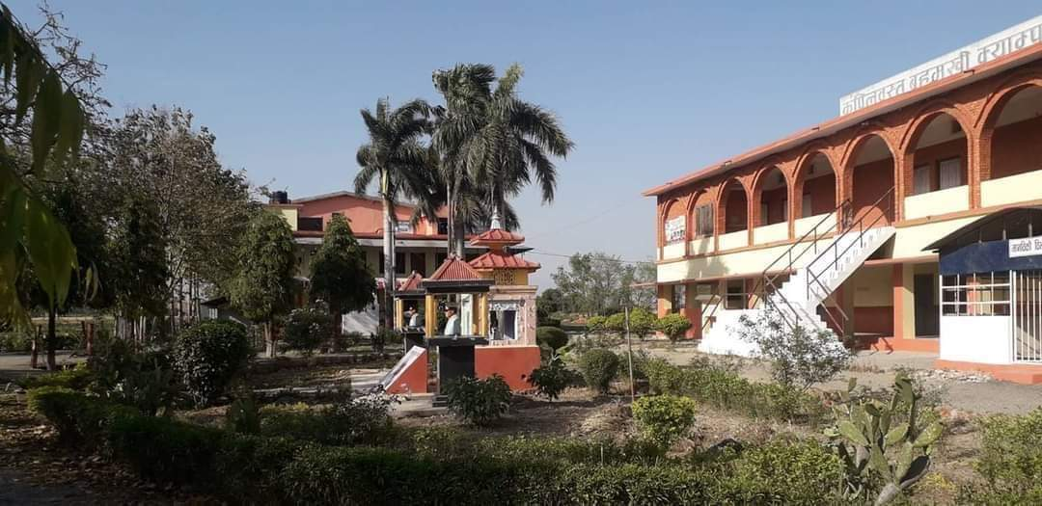
KAPILVASTU MULTIPLE CAMPUS, TAULIHAWA, KAPILVASTU
KMC-HUMANITIES & SOCIAL SCIENCE
ACADEMIC PROGRAM FOR BACHELOR OF ART (B.A.)
Notes:
About
History
The Campus also has a separate humanities building for the Department and classes of Humanities Department. The building has 3 stories with 1 department office, 1 store room, and 8 classrooms. It consist an library in the second story. In 2019 the building opened in KMC. The focus is on English, Sociology, Rural Development, Economics and Additionally, Statistics and Mathematics. The roots of the College can be traced back even further to the Portsmouth and KMC Humanities and Social Sciences.
Education
The staff invested in the team of learning development tutors - on a FOHSS course, you will have access to support in developing the academic skills needed to succeed in your bachelor, degree, and your confidence in them. This includes matters of academic style, data handling, research methods and - for students in KMC - English language skills.
Research
Research in the Faculty is a key activity, embracing PhD study, academic research projects and partnerships with external bodies. Our research centres exist to offer our researchers an academic arena to share and explore their field, benefit from professional support, and gain access to staff with wide experience of securing and managing bids and contracts.
Social Research:-
Social research pertains to study of socio-cultural implications of the social issues.
In this regard, different scientific discipline have influenced social research in terms of theorisation as well as method adopts in the pursuit of knowledge.
Consequently, it embraces the conceptualization of the problem, theoretical debate, specification of research practices, analytical framework and epistemological presupposition.
Social research in rural development depends on empirical methods to collect information regarding matter concerning social issues.
In trying to seek explanations for what is observed, most scientists usually make use of positivistic assumptions and perspectives.
However, the phenomenologist challenges these assumptions and concentrates primarily on experimental reality and its descriptions rather than on casual explanations.
In critical research, the researcher is prepared to abandon lines of thought which do not get beneath surface appearances.
It involves a constant questioning of perspective and the analyses that the researcher is building up.
Career
The Faculty employs Learning Development Tutors between its our college . If you are studying an FOHSS course, they will be available to support you in developing the academic skills needed to succeed in your degree, and your confidence in them. This includes matters of academic style, data handling, research methods and - for students in KMC - English language skills.

Slide 2
FACULTY OF HUMANITIES AND SOCIAL SCIENCES
Established with Kapilvastu Multiple Campus itself in 2019, the Faculty of Humanities and Social Sciences (FOHSS) is one of the Department in terms of number of students and range of programs and courses offered.
It has a mission of educating students and developing them into informed citizenry as well as producing quality human resources required for the nation.
In order to revitalize and upgrade humanities and social sciences education, FOHSS has prepared a strategic plan to move ahead with some specific vision, mission and goals identifying the areas of intervention.
Vision, Mission and Goals
Vision: FOHSS as leading Faculty of KMC aims at being a widely recognized leading academic institution throughout the world in imparting quality education and offering relevant courses with integration of modern technology in teaching, learning and research.
Mission: FOHSS has the mission of educating students and developing them into informed citizenry as well as producing quality human resources required for the nation by offering relevant academic courses, developing new curricula, and creating friendly and conducive environment for learning and scholarship.
Goals: Upgrade humanities and social sciences education through quality teaching/learning and research activities, including regular update of courses offered by FOHSS. Towards that goal, FOHSS has been offering course on number of disciplines in humanities and social sciences. The programs and courses are run through the Faculty of KMC and four year Bachelor level programs. FOHSS also offers courses on Humanities and Social Sciences, leading to Bachelor degree. These include English, Nepali, Sociology, Rural Development, Economics, Political Science and Philosophy. Additionally, Statistics and Mathematics, which belong to Humanities and Social Sciences. In fact, the Faculty offers Bachelor’s and in future Master’s degrees, in most of the areas mentioned and the areas which are part of the liberal arts education.

Slide 3
Welcome-To-KMC-Humanities-And-Social-Science: Academic Department of Humanities & Social Science: 1. Curriculum Development & Review 2. Course Delivery & Instruction 3. Student Support & Advising 4. Research & Scholarship 5. Quality Assurance & Accreditation 6. Community Engagement & Collaboration 7. Qualification & Skill

Slide 4
1. Curriculum Development & Review :
--Interdisciplinary Approach
--Critical Thinking and Analysis
--Research and Writing
--Historical Context
--Cultural Diversity
--Ethical Considerations
--Contemporary Relevance
--Primary Source Material
--Technology Integration
--Collaborative Learning
--Feedback from Stakeholders
--Assessment of Critical Skills
--Flexibility and Adaptability
Notes:
Remember that curriculum development and review should be an iterative process that incorporates feedback, stays updated with the latest research and developments, and remains aligned with the goals of academic institutions and the broader society.

Slide 5
2. Course Delivery & Instruction :
--Active Learning
--Socratic Method
--Multimodal Instruction
--Case Studies and Real-World Examples
-- Close Reading and Textual Analysis
-- Field Trips and Cultural Experiences
-- Student-Centered Discussions
-- Writing and Communication Skills
-- Guest Speakers
-- Ethical Debates
-- Technology Integration
-- Cultivate Inclusivity
-- Encourage Independent Research
-- Feedback and Reflection
-- Interdisciplinary Connections
Notes:
Course delivery and instruction in the academic development of humanities and social sciences should be designed to engage students in critical thinking, foster intellectual curiosity, and encourage meaningful discussions. By employing these instructional strategies, educators can create engaging and meaningful learning experiences in the academic development of humanities and social sciences, fostering a deeper understanding of the subject matter and its broader implications.

Slide 6

3. Student Support & Advising :
-- Academic Advising
-- Orientation Programs
-- Individualized Planning
-- Mentorship Programs
-- Regular Check-ins
-- Career Counseling
-- Internship and Experiential Learning Support
-- Writing and Research Support
-- Inclusivity and Diversity Programs
-- Workshops and Seminars
-- Student Organizations
-- Study Groups and Tutoring
-- Health and Well-Being Support
-- Recognition and Awards
-- Feedback Mechanisms
Notes:
Student support and advising are critical components of academic development in humanities and social sciences. Effective support and guidance can help students succeed academically, develop their interests, and make informed decisions about their educational and career paths. By providing comprehensive student support and advising services, educational institutions can foster a positive learning experience for humanities and social science students, helping them reach their full potential and succeed in their chosen careers.

Slide 7
4. Research & Scholarship :
-- Original Research
-- Interdisciplinary Research
-- Peer-Reviewed Publications
-- Presentations and Conferences
-- Research Ethics
-- Digital Humanities
-- Long-Term Research Projects
-- Research Grants and Funding
-- Collaborative Research Groups
-- Engaging with Communities
-- Book Publications
-- Archival Research
-- Data Collection and Analysis
-- Citation and Academic Integrity
-- Public Engagement
Notes:
Research and scholarship play a crucial role in the academic development of humanities and social sciences. They contribute to the advancement of knowledge, inform teaching practices, and deepen our understanding of human behavior, societies, cultures, and historical contexts. Thus Research and scholarship in humanities and social sciences continuously shape the fields' knowledge base, enriching education and contributing to societal development. By fostering a strong research culture, academic institutions can provide an intellectually stimulating environment that benefits students, faculty, and the broader community.

Slide 8
5. Quality Assurance & Accreditation :
-- Curriculum Review and Alignment
-- Learning Outcomes Assessment
-- External Evaluation and Peer Review
-- Faculty Qualifications and Development
-- Student Support Services
-- Research and Scholarship Evaluation
-- Facilities and Resources
-- Inclusivity and Diversity
-- Continuous Improvement
-- Accreditation Agencies
-- Benchmarking and Best Practices
-- Student Assessment and Feedback
-- Adherence to Regulations
-- External Stakeholder Engagement
-- Transparency and Accountability
Notes:
Quality assurance and accreditation are essential components of ensuring the academic development of humanities and social science programs meet rigorous standards of excellence. These processes aim to maintain the quality and relevance of education, foster continuous improvement, and provide assurance to students, parents, employers, and other stakeholders. So, By implementing robust quality assurance and accreditation practices, institutions can continuously enhance the academic development of humanities and social science programs, prepare students for successful careers, and contribute to the advancement of knowledge in these disciplines.

Slide 9
6. Community Engagement & Collaboration : -- Service-Learning Projects -- Partnerships with Local Organizations -- Internships and Externships -- Collaborative Research -- Public Lectures and Forums -- Community-Based Research Projects -- Cultural Exchange Programs -- Field Visits and Immersive Experiences -- Community Impact Assessments -- Publications and Media Outreach -- Community Advisory Boards -- Social Justice Initiatives -- Community-Based Learning Spaces -- Community Events and Workshops -- Volunteer Opportunities
Notes:
Community engagement and collaboration are integral aspects of the academic development of humanities and social science programs. These disciplines often deal with human interactions, cultures, and societies, making community involvement and collaboration vital for enriching the learning experience and creating a positive impact beyond the academic setting. By fostering community engagement and collaboration, academic institutions can create a meaningful and reciprocal relationship with the community, promoting social responsibility and enhancing the academic development of humanities and social science programs. Additionally, these interactions enrich students' educational experiences and prepare them to be active and responsible citizens in a global society.

Slide 10
7. Qualification & Skill :
--Qualifications: Advanced Degrees, Specialization, Research Experience, Teaching Experience, Continuing Professional Development.
--Skills : Critical Thinking, Communication Skills, Research and Analytical Skills, Interdisciplinary Perspective, Empathy and Cultural Awareness, Information Literacy, Collaboration and Teamwork. Creativity and Innovation, Ethical Awareness, Adaptability, Problem-Solving Skills.
Notes:
In the academic development of humanities and social science, both qualifications and a diverse set of skills are essential for educators, researchers, and students to thrive in their respective roles. So, By possessing the necessary qualifications and developing a diverse set of skills, individuals involved in the academic development of humanities and social science can make significant contributions to their respective fields, engage students effectively, and generate valuable insights for societal progress.

Slide 11
Meeting minutes
Departmental meeting minutes for skills development courses
Departmental meeting minutes for Remedial classes
Event’s review meeting minutes
Department’s course revision meeting minutes
Minutes of Interaction program with academic peers & employers
Minutes of Evaluation scheme
Departmental meeting minutes for research supervisor
Minutes of the academic departments for Teaching Plan/Lesson Plan of Faculty in EMIS to study the impact of information system.
Minutes of selection committee for new appointments
Minutes of the department for developing computer aided learning packages using the Computers
Admission campaign minutes
Minute of Student Welfare, External Affairs and Extracurricular Activity Unit for Annual Sports week program
Department minute for Guest Lecture Classes
Notes:
Meeting minutes serve as a valuable tool for academic development in humanities and social science departments, facilitating communication, coordination, and strategic planning among faculty members and supporting the overall growth and advancement of the department.

Slide 12
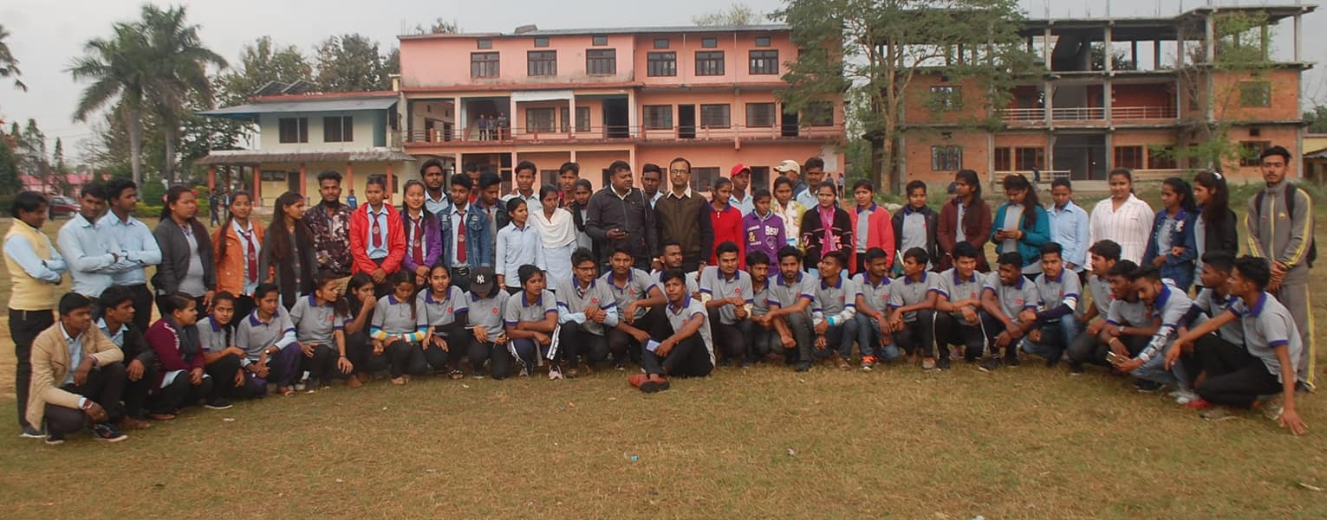
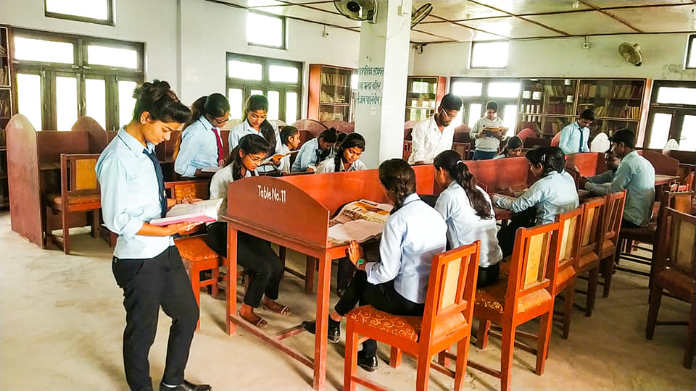
Notes:
KMC-Humanities and Social Science
" Inclusive , good-quality education is a foundation for dynamic and equitable societies ."
THINK GLOBAL !!! Select , Kapilvastu Multiple Campus ( KMC ) Taulihawa offering wide range of cources in Science , Management , Hotel Management , Law , Computer Science , Education , Humanities(Sociology, Anthropology, Social Worker, Rural Development).
Why study humanities and social sciences ?
Why we are Great ..................???
Our Teaching is underpinned by research.
New ideas and theories are tested in the classroom.
You acquire a range of skill valued by employers including research, interpreting data and debating .
You develop the critical and inventive thinking skills necessary for many Graduate Jobs .
Why Higher Education in Kapilvastu Multiple Campus (KMC) , Taulihawa ???
Using SMART Board , Electronic Whiteboard which connect with computer & projector in classroom.
Using EMIS System , Teaching & Learning by Online Virtual Classes (Due to the epidemic) .
ICT Lab & Research Lab
Training & Seminar Hall
Webcam Facilities
CCTV-Camera Service
Quality Programme
Educational Activity
Extra Curricular Activity
Appropriate Class Size
Student Success rate higher
Language & Academic Support
Student mentor program
Friendly & Experienced Staff
Experienced Lecturer
Student Leading Career Service
Student´s Hostel
Lecturer Residence
Effective Well Equiped Library
Facultywise laboratory
Science laboratory
Research & Proposal writing training
Playground , Pond, Flower Garden
Inner City Location ...............???
The KMC-College welcomes to you for online admission due to the epidemic disease covid-19 , which links are given below :- Registration Link : http://emis.kmctlw.edu.np/student-enrollment
#Admissionopen
#KapilvastuMultipleCampus
#science_management_humanities_Education............
THANK YOU and Best of Luck for your upcoming future .....

Slide 13

Its Time for Your
Valuable Feedback ???
Do You
Have any
question ?.....
OR
Query……………..???
KMC-Humanities
and
Social Science

Slide 14
Thanks for your valuable time to giving me an opportunities to show the presentation Prepared & Presented By: Mr. Bishnu Singh Rayamajhi

